Slide 1
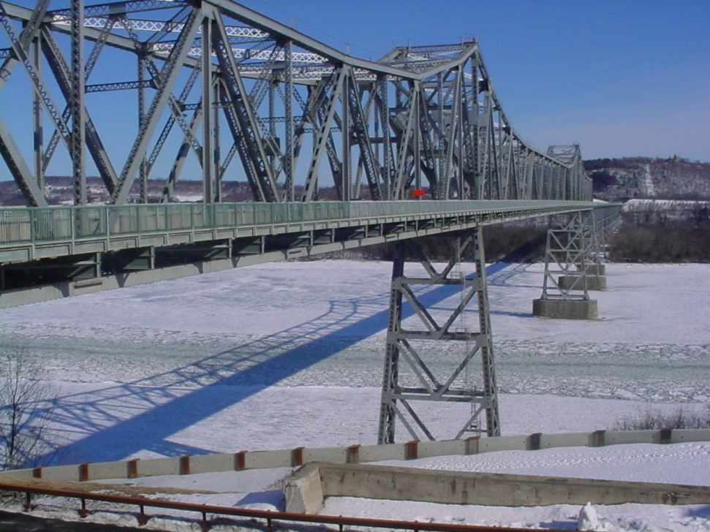
Rip Van Winkle Bridge
New York State bridge authority

Slide 2
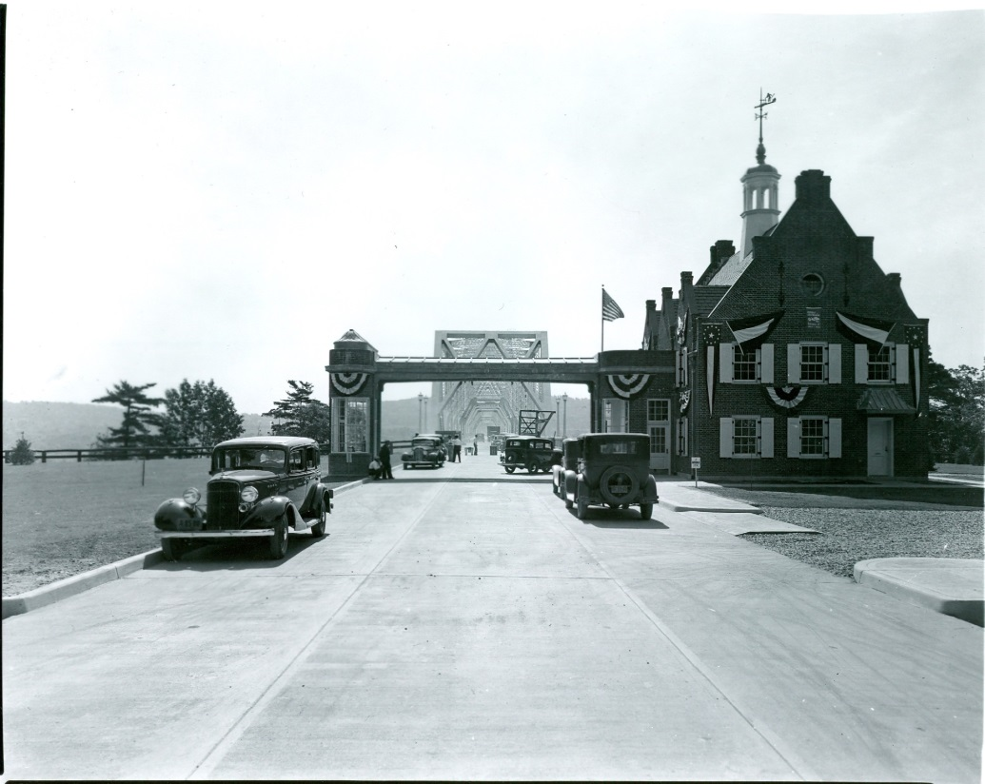
When did this bridge open?
The Rip Van Winkle Bridge opened on July 2nd 1935

Slide 3
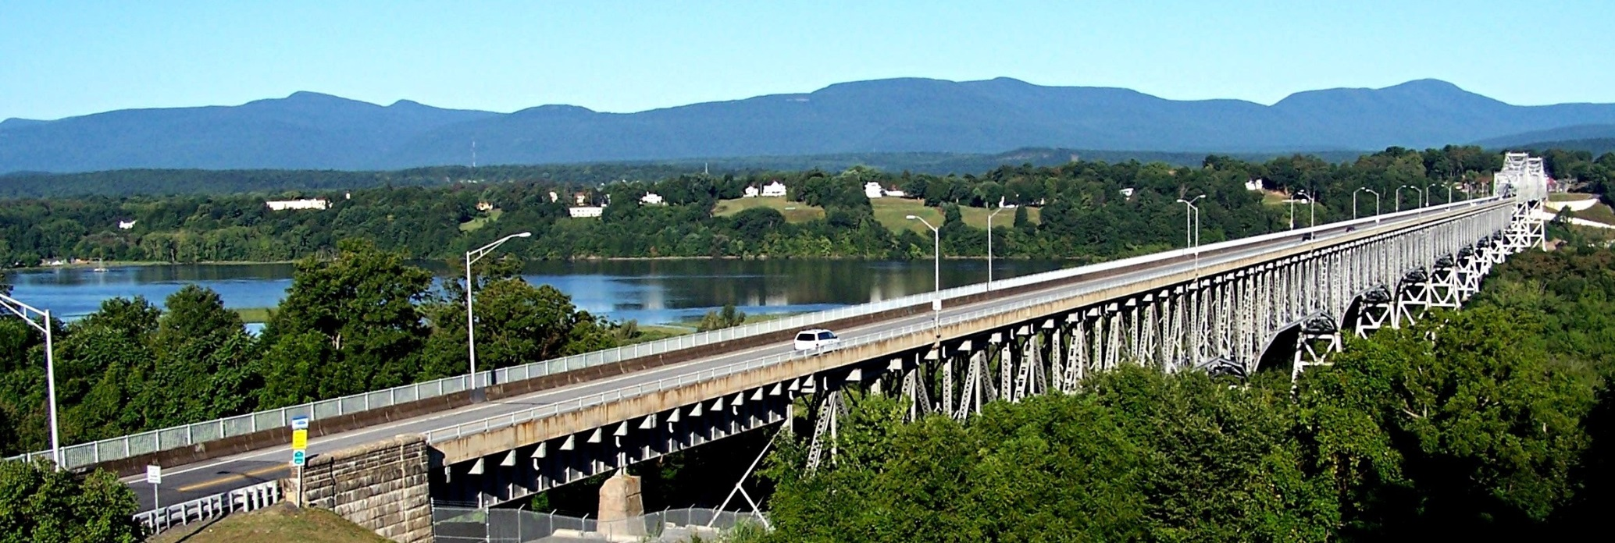
How long is this bridge ?
5,041 feet!

