Slide 1
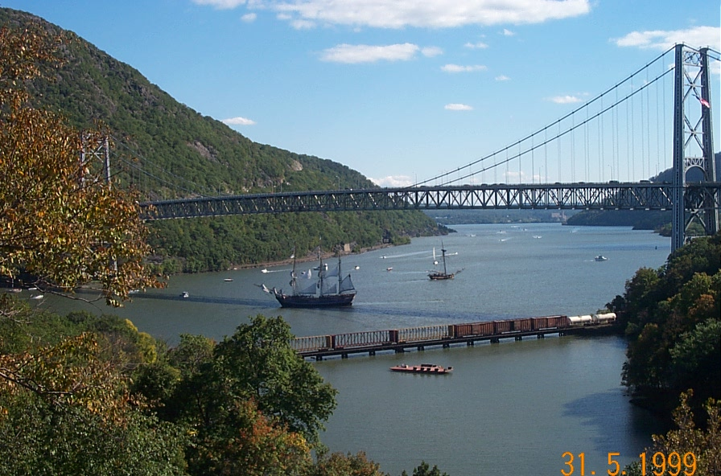
Bear Mountain Bridge
New york state bridge authority

Slide 2
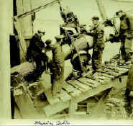
How old is the Bear Mountain Bridge?
90 years old, the bridge opened November 27th 1924

Slide 3
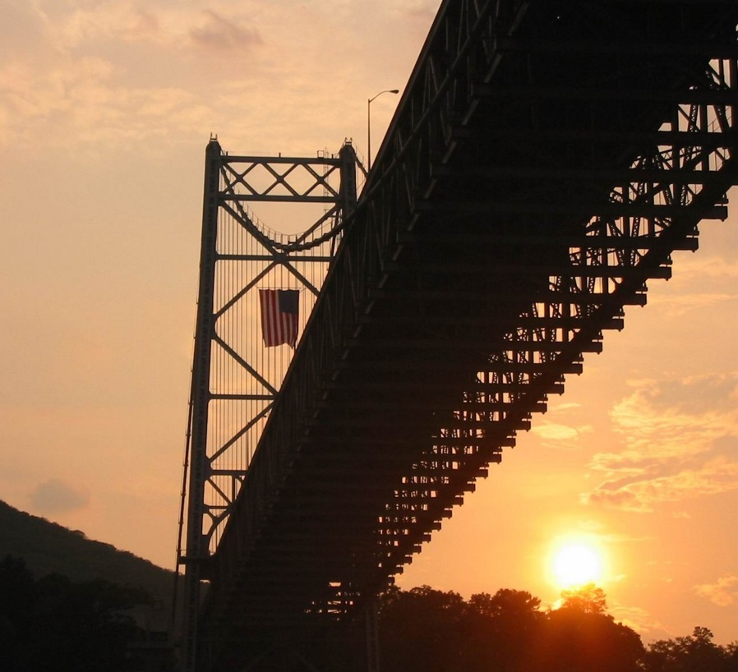
Did you know?
The Bear Mountain Bridge is the oldest of the New York State Bridge Authority’s Bridges

Slide 4
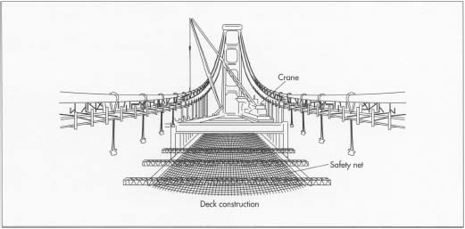
What type of bridge is the Bear Mountain?
Parallel cable wire suspension bridge

