Slide 1
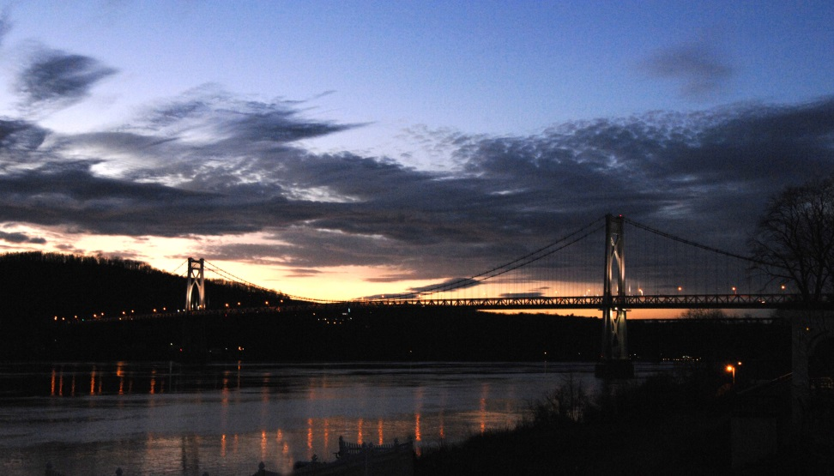
Mid-Hudson Bridge
New york State bridge authority

Slide 2
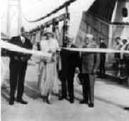
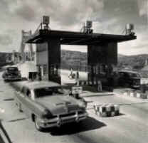
How old is the Mid-Hudson Bridge ?
84 years old, the bridge opened August 25th 1930.

Slide 3
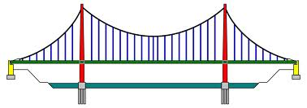
What type of bridge is the Mid-Hudson?
Suspension Bridge

Slide 4
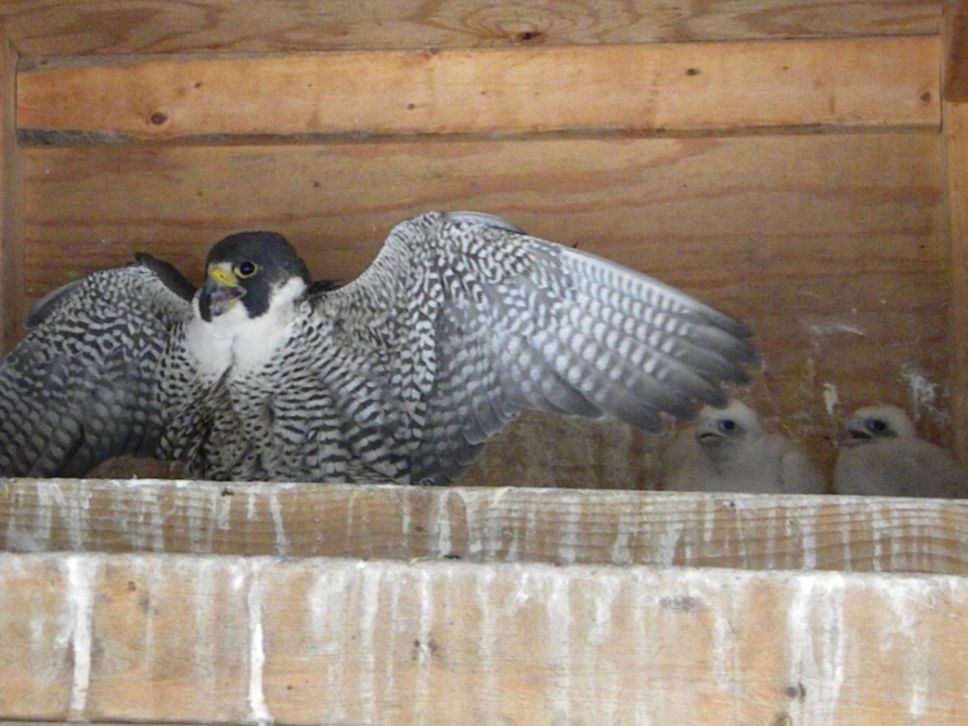
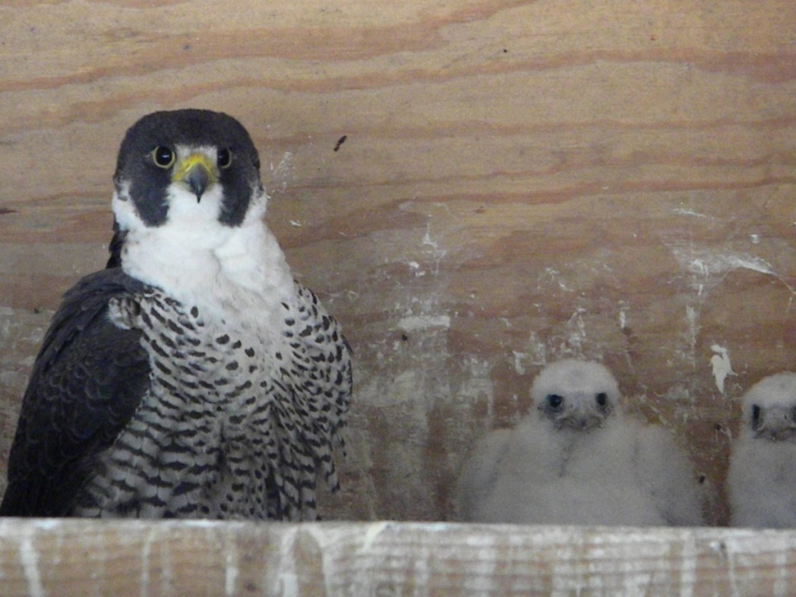
The Mid-Hudson Bridge is also home to Peregrine Falcons…
Our bridges provide a safe home for these endangered birds.

