Slide 1
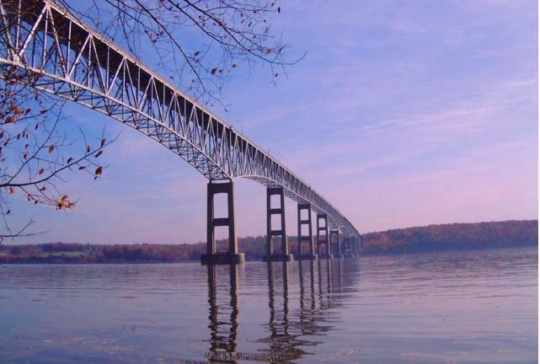
Kingston-Rhinecliff Bridge
New York state bridge authority

Slide 2
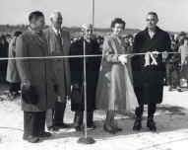
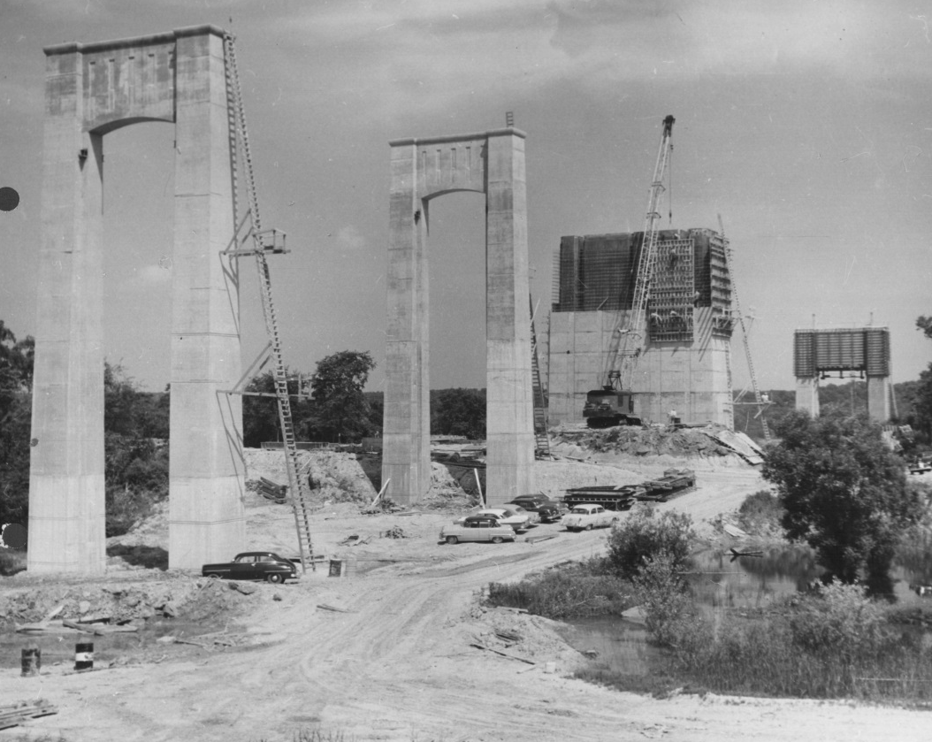
How old is the Kingston-Rhinecliff Bridge?
57 years old, it opened on February 2nd 1957

Slide 3

What type of bridge is this?
Continuous Under-Deck Truss

Slide 4
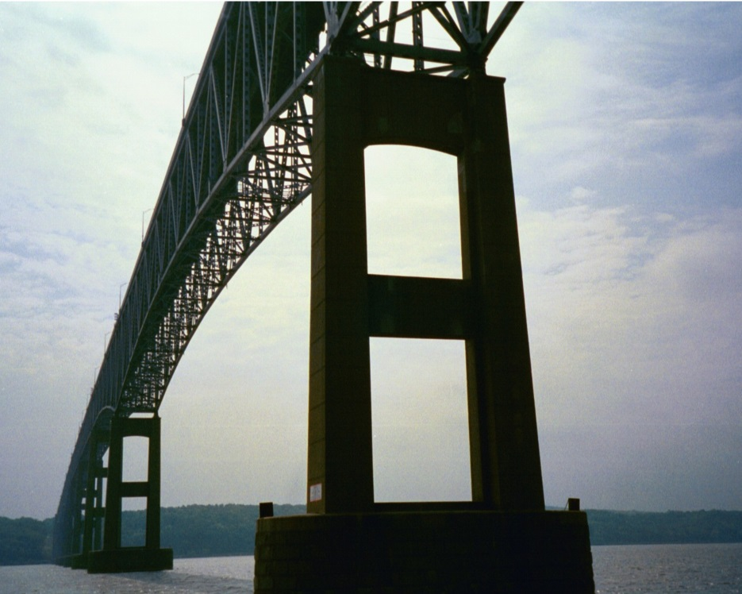
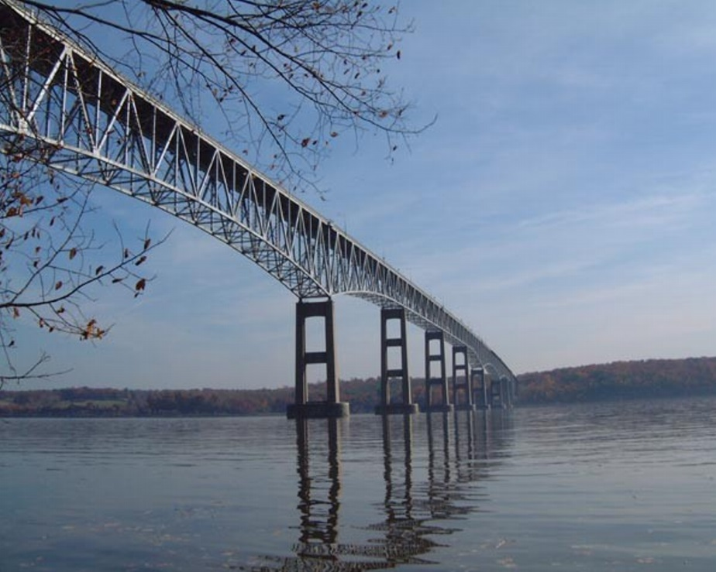
How long is the bridge?
7,793 feet

