Slide 1
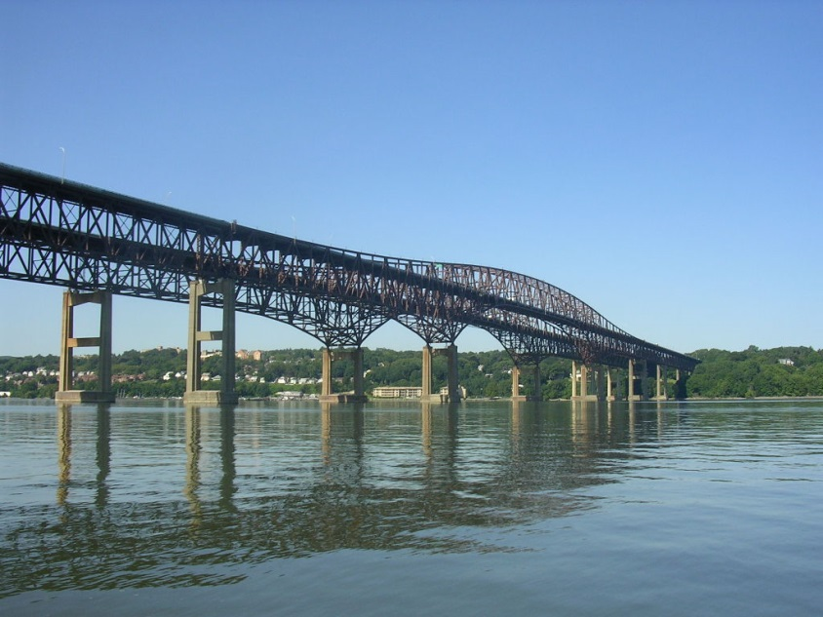
Newburgh-Beacon Bridge
New york state bridge authority

Slide 2
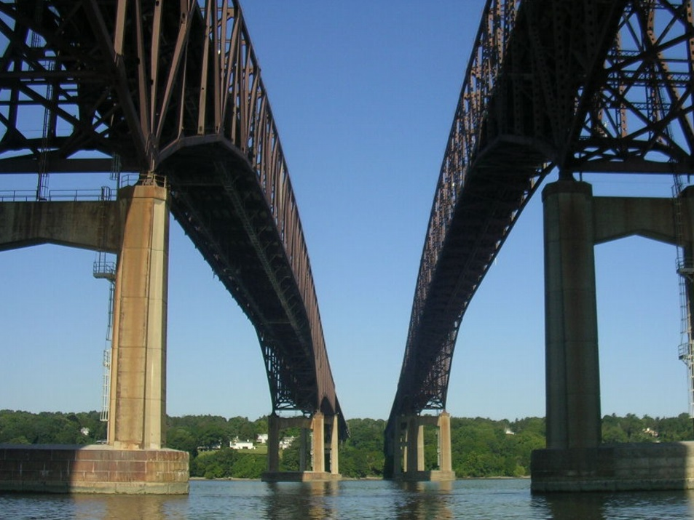
Did you know?
The Newburgh-Beacon Bridge is two spans. The second span was opened 17 years after the first.

Slide 3
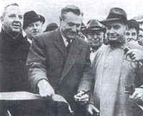
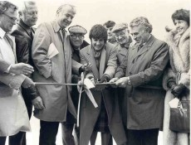
When did these bridge spans open?
North Span: Novemeber 2nd 1963
51 years ago
South Span: November 1st 1980
34 years ago

Slide 4
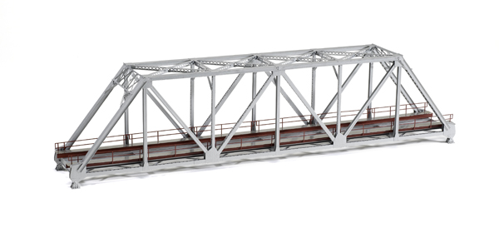
What type od bridge is the Newburgh-Beacon ?
Cantilever Truss Bridge

Slide 5

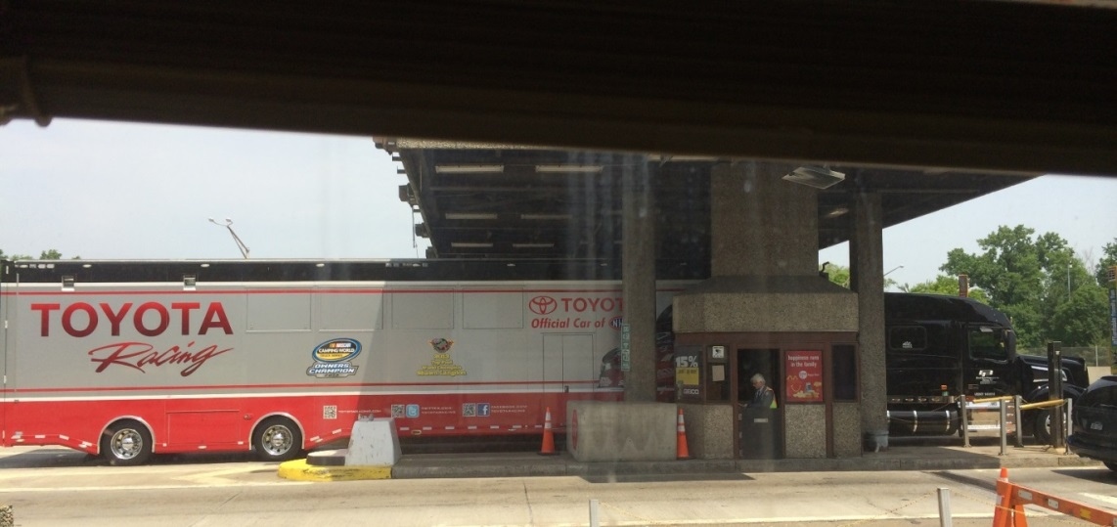
Things that cross The Newburgh-Beacon Bridge
Racing Teams

Slide 6
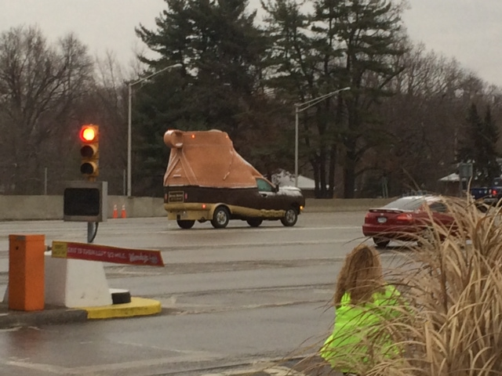

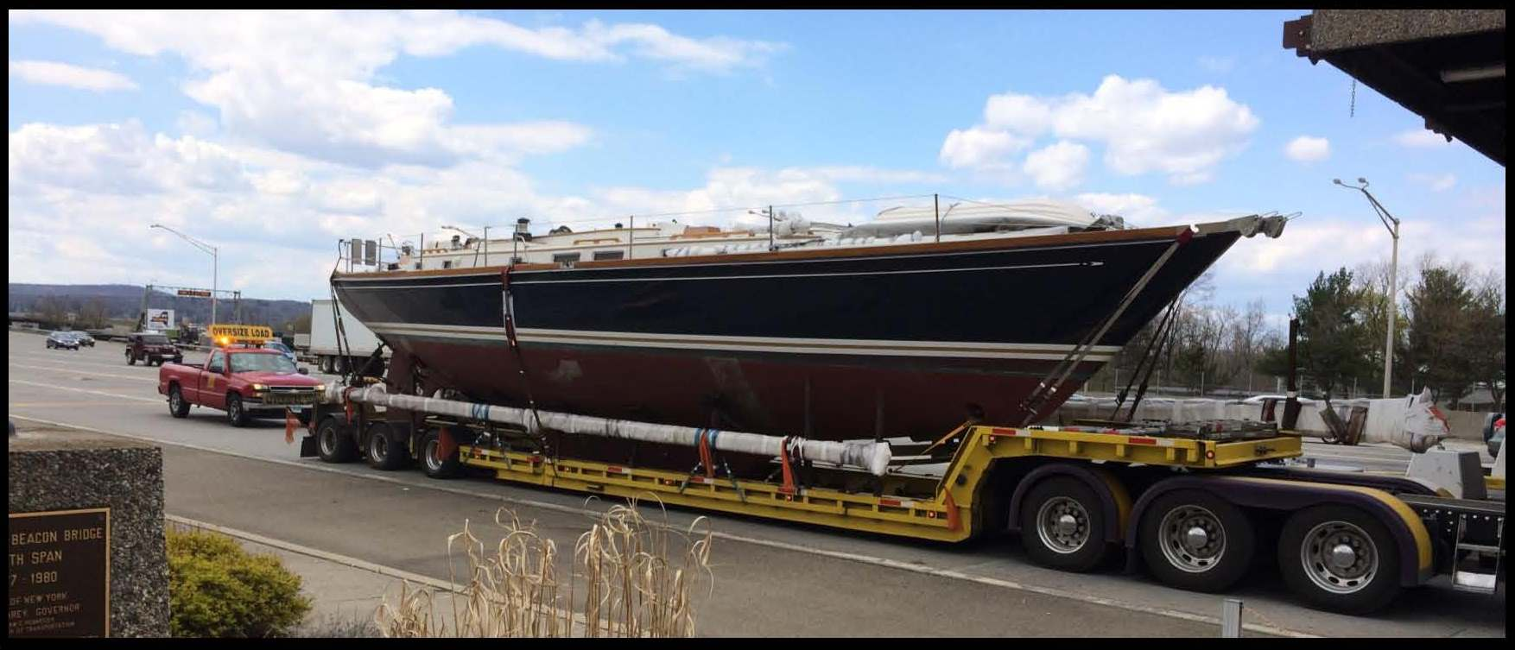
Snow Boots
Turkey Hill Ice Cream
And Boats!

Slide 7
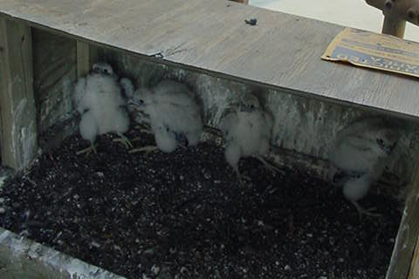
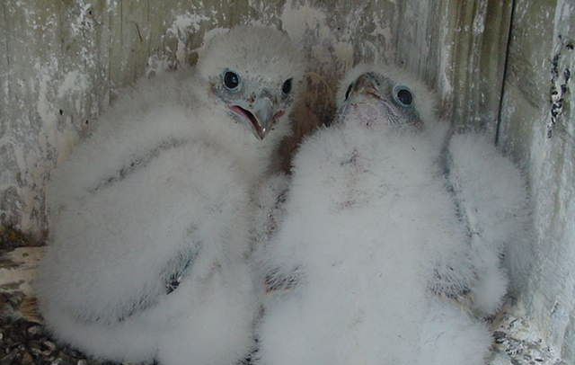
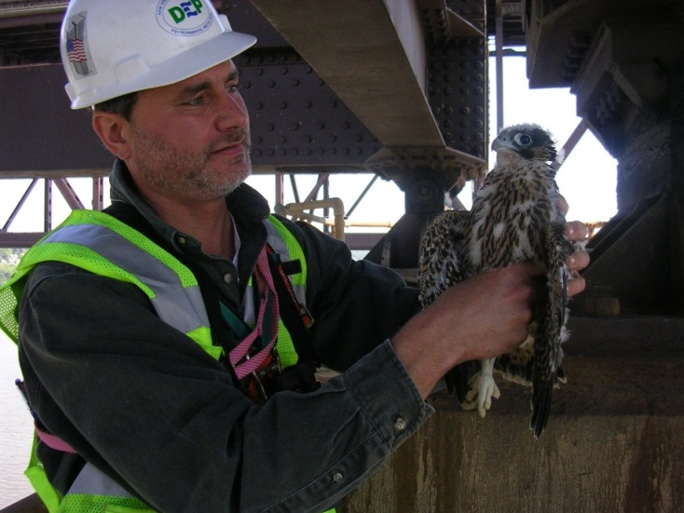
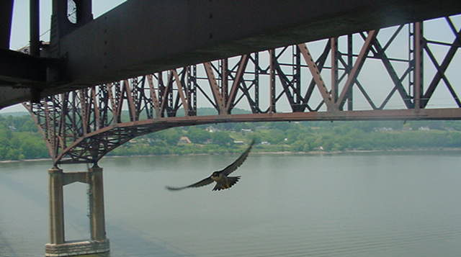
Meanwhile, under the bridge…

